Slide 1
lrd: An R Package and Shiny Application for Quickly Scoring Lexical Data in R
Nicholas p. maxwell¹, Mark J. HUFF¹, Erin M. Buchanan²
¹ the university of southern Mississippi, ² Harrisburg University OF Science and Technology

Slide 2
Introduction
Recall testing is commonly used to gauge memory retrieval
Cued-recall testing
Free-recall testing

Slide 3
Introduction
Recall testing has been used extensively throughout psychological research
Approximately 18,000 publications since 2000
Across multiple subfields of psychology

Slide 4
Introduction
This can be partly attributed to the rise of the internet and more powerful computers
Online recruitment platforms like Prolific or Mturk
Large-scale normed databases for stimuli creation (English Lexicon Project; Balota et al., 2007; Small World of Words; De Deyne et al., 2019)
Tools for automatically generating stimuli (lexOPS; Taylor, Beith & Sereno, 2019)
Notes:
However, little attention has been paid to creating tools for processing the large amounts of data that are generated from these studies

Slide 5
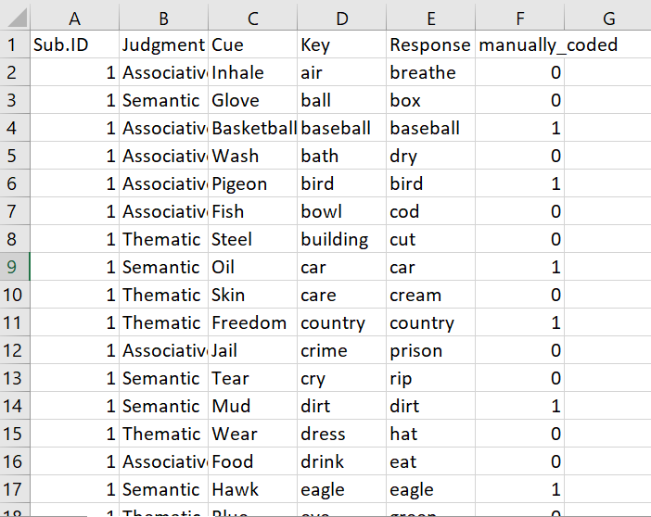
Cued-Recall Example
Cued-recall data is scored by matching participant response to a key.
Time intensive and error prone!
Notes:
Time intensive and error prone! This was taken from an actual dataset I hand coded – 13,924 rows!

Slide 6
Introduction
An alternative is to automate the coding process
Must be able to account for spelling errors!
This requires a sufficient degree of flexibility to be programmed into the scoring package
Notes:
Simple text matching won’t work! Misspellings, embedded code leftover from survey software, etc.

Slide 7
The lrd Package
lrd (Lexical Response Data) is an R package designed to automate scoring of recall data while controlling for participant errors.
Cued-recall
Free recall
Sentence responses
Open source and freely available via Gitihub
Notes:
To address this, I created lrd, which is an R package designed to scored data. It also contains several functions for plotting data and interpreting scored output

Slide 8
The lrd Package
lrd scores recall data using Levenshtein distances
Number of character insertions, deletions, or changes required to transform a word
“Cat” and “Bat” have a Levenshtein distance of 1 while “Mouse” and “Mice” have a distance of 4
lrd scores data using Levenshtein distances ranging from 0 – 5
User selects this cutoff when scoring

Slide 9
The lrd Package
lrd is also available as an R Shiny application!
Shiny provides and interactive GUI for using lrd. No programming required!
https://github.com/npm27/lrd/

Slide 10
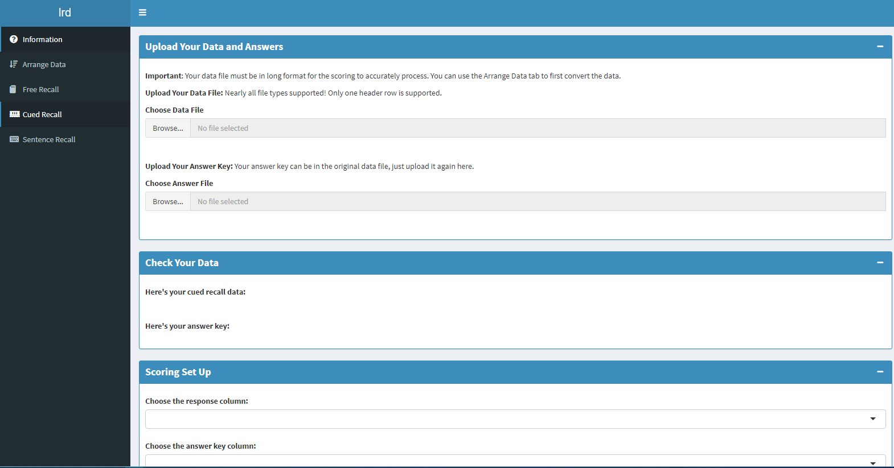

Slide 11
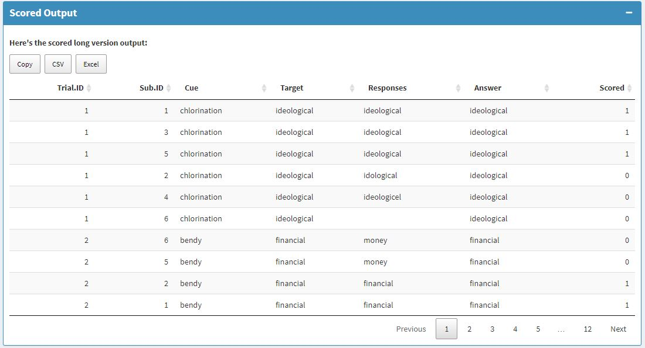

Slide 12
Testing lrd vs Manually Coded Data
Tested whether mean recall differed between manually coded data and each level of lrd scoring (ANOVAs)
Sensitivity and specificity analyses
Sensitivity = proportion of true positives
Specificity = proportion to true negatives
Notes:
Used lrd to score sets of cued and free-recall data and compared to manually coded data

Slide 13
Cued-Recall
Cued-recall data taken from two studies
Maxwell & Buchanan (2020)
Maxwell & Huff (in press)
Combined dataset contained 31,301 observations taken from 334 participants

Slide 14
Results
Study | Manual | Lev 0 | Lev 1 | Lev 2 | Lev 3 | Lev 4 | Lev 5
Maxwell & Buchanan | 54.14 | 50.72 | 52.14 | 53.37 | 61.30* | 77.42* | 88.48*
Maxwell & Huff | 43.96 | 41.06 | 43.11 | 44.86 | 50.83* | 64.84* | 77.69*
* = p < .05 relative to manually coded

Slide 15
Results
Study | Manual | Lev 0 | Lev 1 | Lev 2 | Lev 3 | Lev 4 | Lev 5
Maxwell & Buchanan | 54.14 | 50.72 | 52.14 | 53.37 | 61.30* | 77.42* | 88.48*
Maxwell & Huff | 43.96 | 41.06 | 43.11 | 44.86 | 50.83* | 64.84* | 77.69*
* = p < .05 relative to manually coded
For both datasets, recall rates matched the closest using a Levenshtein distance of 2
Notes:
Notice how recall rates increase with flexibility

Slide 16
Results – Sensitivity/Specificity
Maxwell & Buchanan (2020)
Maxwell & Huff (in press)
Scoring Cutoff | Sensitivity | Specificity
0 | 99 | 94
1 | 99 | 96
2 | 97 | 96
3 | 80 | 97
4 | 47 | 98
5 | 24 | 99
Scoring Cutoff | Sensitivity | Specificity
0 | 99 | 93
1 | 99 | 97
2 | 97 | 98
3 | 87 | 99
4 | 62 | 99
5 | 40 | 99
Sensitivity/Specificity were both maximized when using cutoff of 1 at scoring.
Notes:
Sensitivity = True positives (lrd correctly marks a word correct); specificity true negatives (lrd correctly marks a word as incorrect).
0 provides no flexibility in scoring, 5 is highly lenient as it allows for up to 5 character changes/insertions/deletions

Slide 17
Free-Recall
Free recall data taken from Huff, Yates, & Balota (2018)
120 participants completed free-recall tasks for three types of words lists
Adhoc
Categorical
Unrelated

Slide 18
Results
List Type | Manual | Lev 0 | Lev 1 | Lev 2 | Lev 3 | Lev 4 | Lev 5
Adhoc | 50.00 | 48.10 | 48.64 | 48.58 | 49.48 | 49.71 | 49.71
Categorical | 47.86 | 44.13 | 44.60 | 44.71 | 45.56 | 47.19 | 47.19
Unrelated | 37.99 | 37.40 | 37.52 | 37.88 | 38.46 | 38.46 | 38.46
Notes:
Notice how recall rates increase with flexibility

Slide 19
Results
List Type | Manual | Lev 0 | Lev 1 | Lev 2 | Lev 3 | Lev 4 | Lev 5
Adhoc | 50.00 | 48.10 | 48.64 | 48.58 | 49.48 | 49.71 | 49.71
Categorical | 47.86 | 44.13 | 44.60 | 44.71 | 45.56 | 47.19 | 47.19
Unrelated | 37.99 | 37.40 | 37.52 | 37.88 | 38.46 | 38.46 | 38.46
Across list types, lrd was most accurate when using a cutoff of 3 or greater.
Notes:
Notice how recall rates increase with flexibility

Slide 20
Results – Sensitivity/Specificity
 | Adhoc |  | Categorical |  | Unrelated
Scoring Cutoff | Sensitivity | Specificity | Sensitivity | Specificity | Sensitivity | Specificity
0 | 90 | 86 | 98 | 90 | 93 | 87
1 | 98 | 87 | 98 | 91 | 93 | 87
2 | 95 | 95 | 98 | 91 | 92 | 87
3 | 95 | 96 | 97 | 95 | 97 | 96
4 | 96 | 96 | 95 | 94 | 97 | 96
5 | 96 | 96 | 95 | 94 | 97 | 96
Sensitivity/specificity maximized using a cutoff of 3 or greater

Slide 21
Summary
lrd allows researchers to quickly score several types of recall data
lrd can accurately reproduce human coded data
The goal is to provide a standardized, open-source method for processing lexical output across psychological studies.

Slide 22
Questions?

